Slide 1
Website design
Studylitcs pvt ltd

Slide 2
IDs and Pass
Customer number: 419469718
User name: studylytics
Pass: Study@9640s
https://in.godaddy.com
URL- https://studylitcslabs.com/
Email id: studylytics.labs@gmail.com
Pass: Studylytics@2021
Company mail id- director@studylitcslabs.com
manager@studylitcslabs.com
Pass: Study@9640s

Slide 3
Contact details
Managing Director: Pulla Laxmi Prasanna
Technical Manager: Erabati Pallavi
Address: H.No. 35.3.1472, Near SBI Bank, Gopalpur, Warangal Urban-506009.
Name of contact person: Erabati Pallavi
Contact no: 8106761266
Email ID: manager@studylitcslabs.com
Pass- Study@9640s

Slide 4
About us
At Studylitcs labs we provide our extensive services in research and development of new innovative ideas in everlasting materials and energy engineering areas. In today’s modern world we see Engineering and research works are fast evolving. So we choose to give our best services in engineering with our research work by finding problems and giving our best in providing a solution for the problem.
The heart and soul of a good writing is research, you should write not what you know but what you can find out about.- Robert J Sawyer.
5 W’s and H theory is the main theme of out lab
In this What is the problem
Who has initially looked into it
When did the research start in this subject
What are the outcomes I get through this research
Where can I find the solution and How
This is what we believe in what we can find out about.
Research work is all about creating new knowledge. We are here to strive hard to do our work by creating new knowledge in our specified areas like energy harvesting and material engineering. We are also in a way to provide a online course module for the spread of our innovative knowledge along with basic engineering materials and energy harvesting techniques.
This courses gives you a detailed picture of the topic choosen and we will be open for any kind of discussions and queries during the course duration.
We also provide sevices with our processing equipment and characterization equipments.

Slide 5
Services PROCESSING EQUIPMENTS
Environmental Controlled High Temperature Furnace: Heat treatment in controlled atmosphere
Specification: Temperature: Room temperature to 1400 ⁰C
Heating rate : 0.5 0C/min to 10 0C/min
Environment : Air, Nitrogen, etc

Slide 6
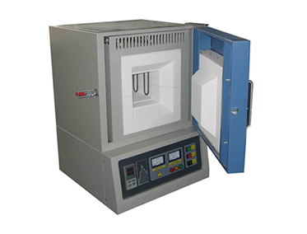
Environmental Controlled High Temperature Furnace

Slide 7
2. Specimen Cutting Machine- Metallic, polymer, etc Specification:
RPM- 1500 max
Wheel size: 33 x 2 x 32 mm
Sample size (max): 30 mm x30 mm

Slide 8
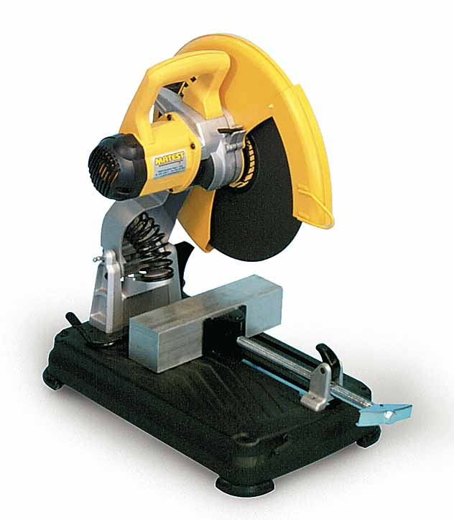
Specimen Cutting Machine

Slide 9
3. Single/Double Disc Polishing Machine- Polishing of samples to get smooth surface finish
Specification:
Diameter of disc: 200 mm Rotation: 300-650 rpm

Slide 10
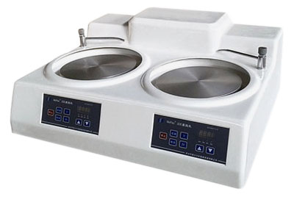
Single/Double Disc Polishing Machine

Slide 11
Universal Testing Machine- Studies of strain-strain behavior of materials
Specification: Max force- 100 kN Cross head speed- 5 mm/min to 100 mm/min Travel length- 450 mm Test types- Tension, Compression, and Flexural

Slide 12
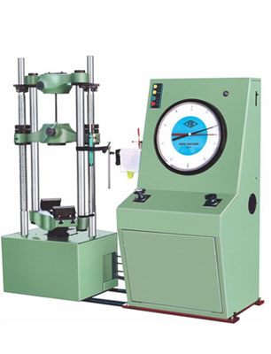
Universal Testing Machine

Slide 13
Characterization Equipment
1. Shore A Durometer- Measurement of hardness for soft materials like rubber
Specification: Preload: 0.45 Kgf Major Load: 8.06 N Indenter type- 35° truncated cone indenter Type of load- Constant contact pressure

Slide 14
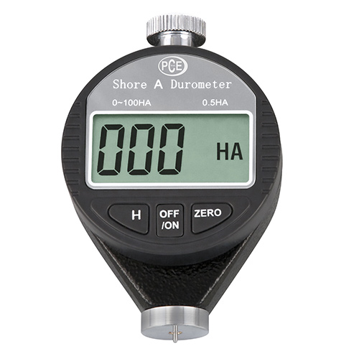
Shore A Durometer

Slide 15
2. Shore D Durometer- Measurement of harness for hard polymer
Specification: Preload: 0.45 Kgf Major Load: 44.48 N Indenter type- 30° cone indenter Type of load- Constant contact pressure

Slide 16
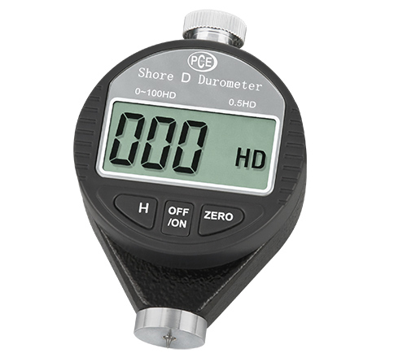
Shore D Durometer

Slide 17
3. Metallography Station Trinolcular Optical Microscope with Camera- To study surface morphology
Specification: Magnification- 25 X to 1200X Focusing: Coarse to fine Head: Monocular, binocular/trinocular Illumination- Halogen, incident light Eye piece: 5X, 10X, 15X and 20 X Objective: 5X, 10X 20X and 40X

Slide 18
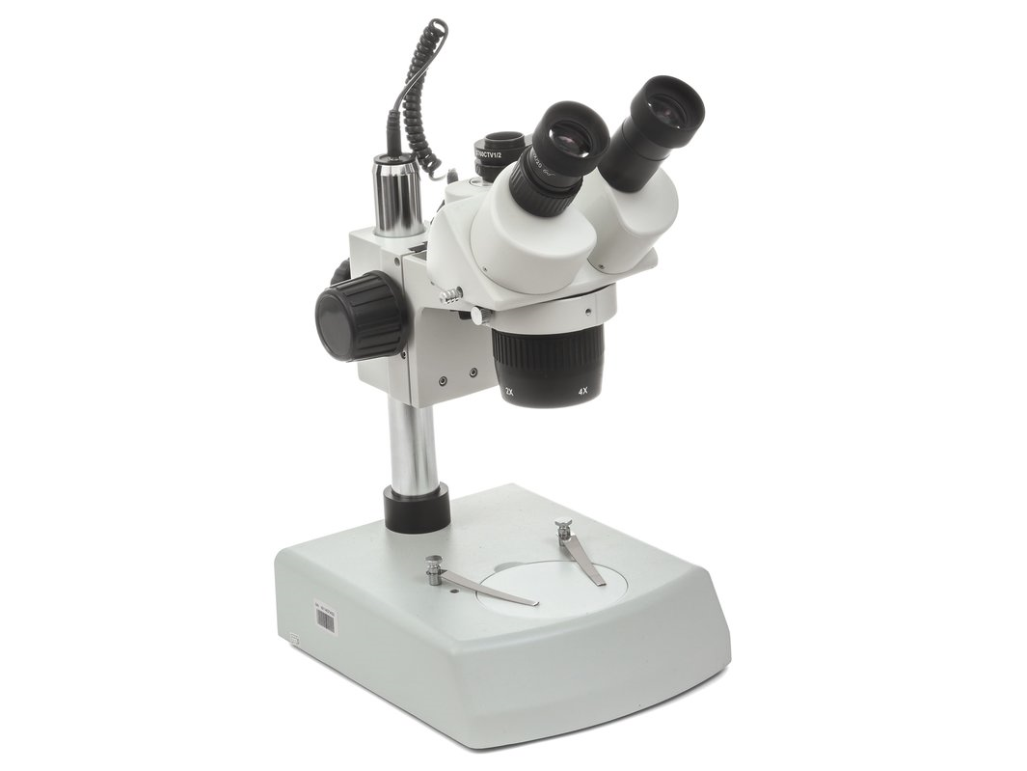
Metallographic Station Trinolcular Optical Microscope with Camera

Slide 19
4. Surface Roughness Tester- Measurement of surface hardness
Specification: Range: 350 m (-200 m to 150 m) Detecting mode: Skid measurement Measuring force: 4mN or 0.75 mN (Low force type) Stylus tip: Diamond, 900/mR (600/2mR: low force type) Travelling length : 6 mm Evolution length (mm) : 1.25, 4.0

Slide 20
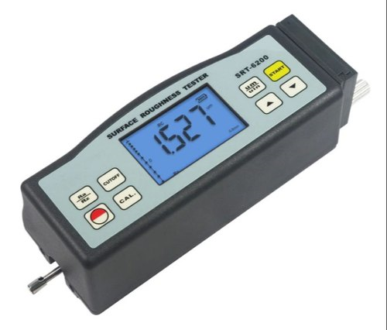
Surface Roughness Tester

Slide 21
5. Superficial Rockwell Tester
Specification: Range: 350 μm (-200 μm to 150 μm) Detecting mode: Skid measurement Measuring force: 4mN or 0.75 mN (Low force type) Stylus tip: Diamond, 900/ 5μmR (600/2 μmR: low force type) Travelling length : 6 mm Evolution length (mm) : 1.25, 4.0

Slide 22
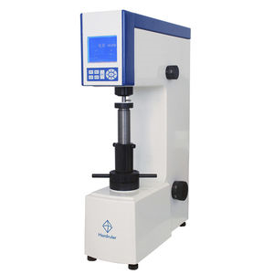
Superficial Rockwell Tester

Slide 23
6. Brinell Hardness Tester- Brinell hardness test of Metals
Specification: Preload: 250 Kgf Major Load - 250-3000 Kgf in range of 250 Kgf 250, 500, 750, 1000, 1250, 1500 Kgf Maximum test height- 410 mm Depth of throat- 205 mm Max depth of spindle below base – 180 mm Steel ball diameter (Indentor)- 10 mm , 5 mm, 2.5 mm

Slide 24
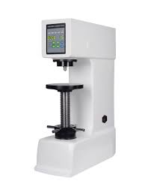
Brinell Hardness Tester

Slide 25
7. Vickers Hardness Tester- Vickers hardness tester of metals
Specification:
Load- 5 Kgf to 50 Kgf 30, 40, 50 Kgf (loads 5, 10, 15, 20 not working properly) Indentor – diamond Magnification- 25 X

Slide 26
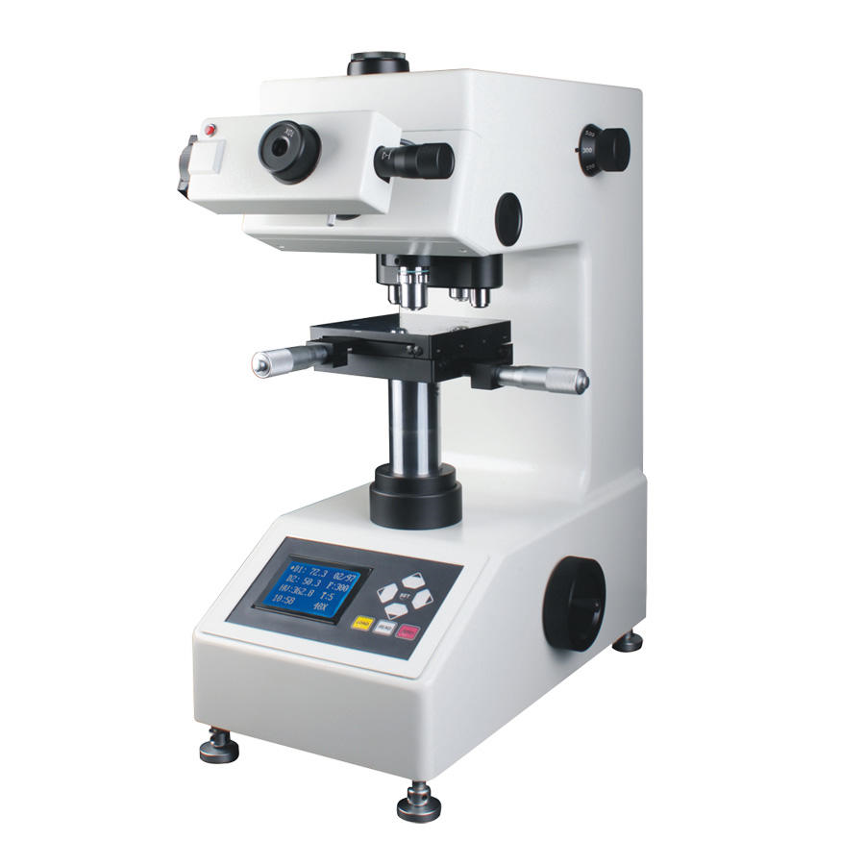
Vickers Hardness Tester

